Slide 1
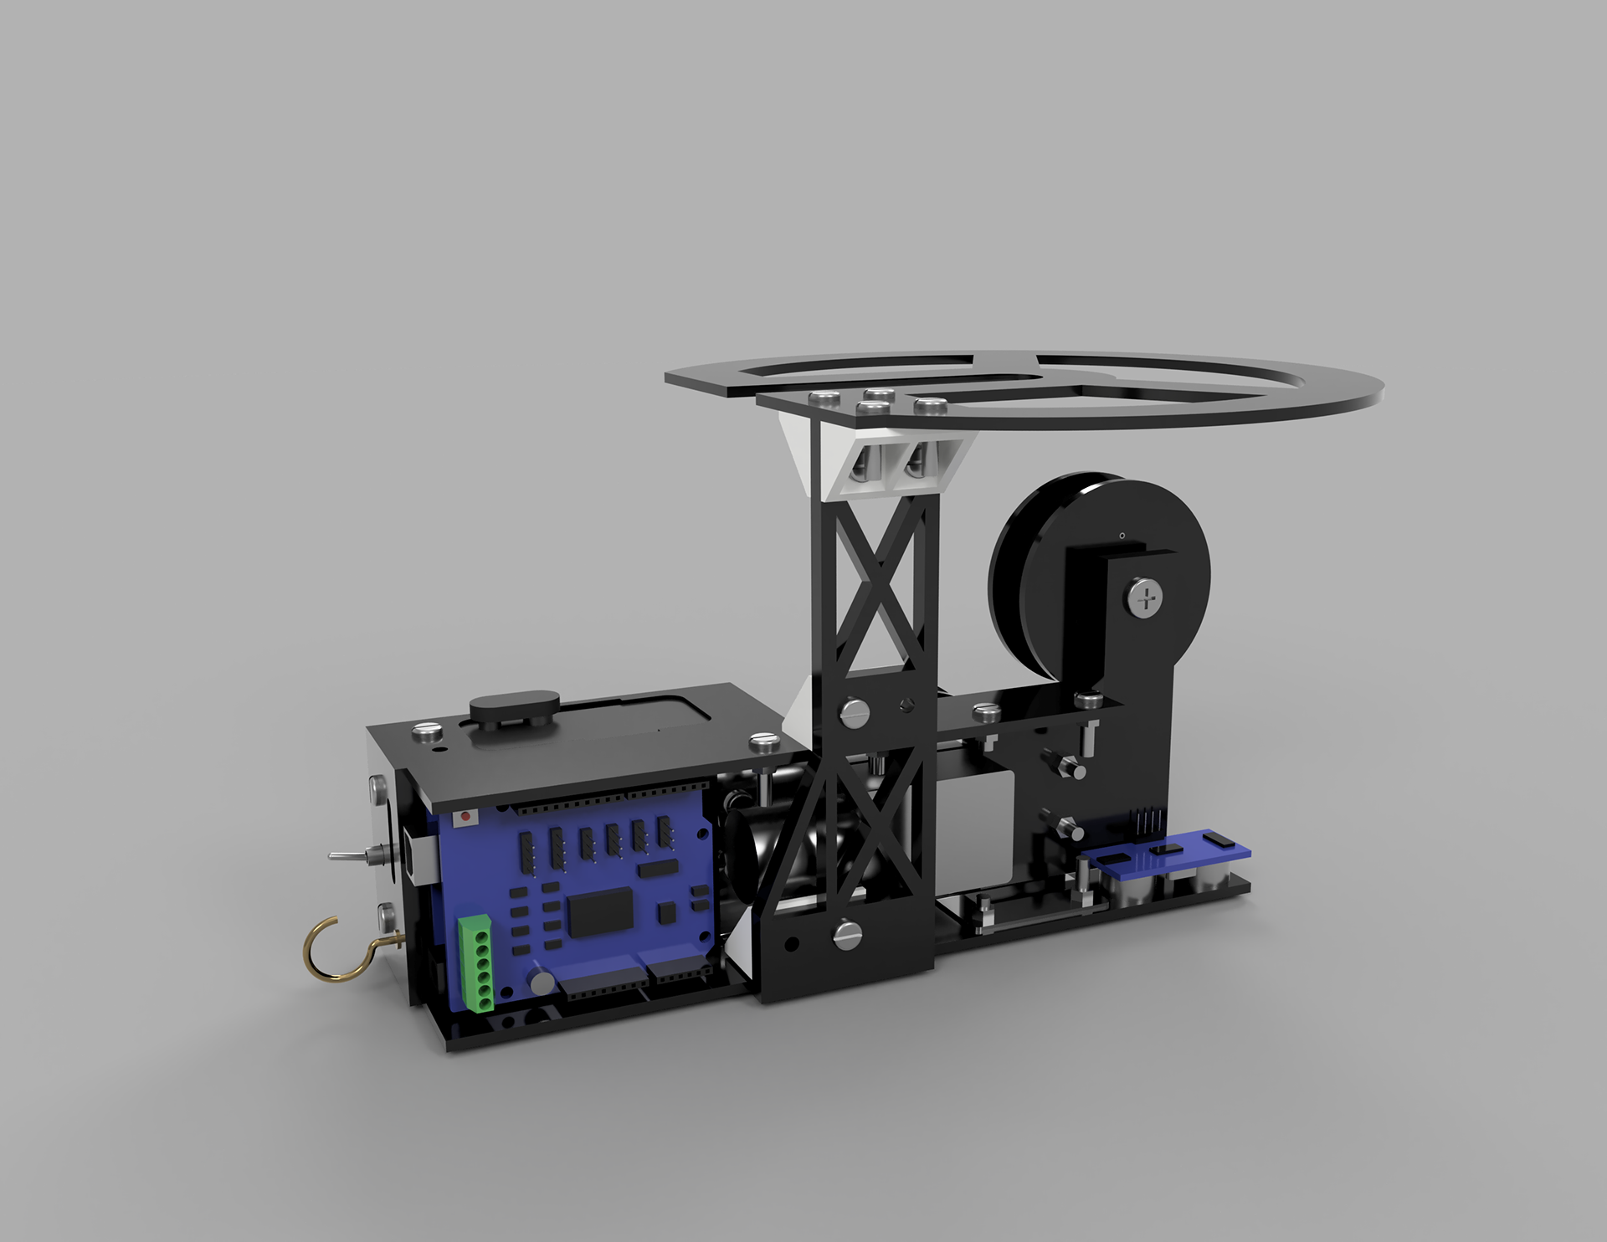
Challenge Brief and Engineering Requirements
Presented by Akbar Qamar​

Slide 2
Agenda
Build one self-contained device for a vertical 22 mm commercial copper pipe.
Climb while lifting the supplied chain, contact the top barrier, dwell with red light and buzzer, descend and release the chain in the correct zone.
The 2026 brief is the authority; do not rely on assumptions or previous designs.

Slide 3

Constraints
Envelope: 400 mm diameter by 300 mm length, excluding the automatic clip.
Budget: AED 250 including the clip.
Green light throughout the run; red light and sound at the top barrier.
No wireless, remote control or GPS. Manufacturing must be student undertaken.
Design for a real, possibly non-plumb, purchased-condition pipe.

Slide 4
What Is Mechatronics?

Slide 5
Mechatronics is the deliberate integration of:
Mechanics: structure, bearings, rollers, gears, fasteners and motion.
Electrics/electronics: batteries, wiring, switches, motors, sensors and drivers.
Control: a sequence of decisions that changes outputs using inputs.
Software: the instructions that implement the control sequence.
Testing: evidence that the complete system performs reliably and safely.
Notes:
Point out that the vehicle fails if any one of these elements is weak.
Mechanical engineering remains central: it creates the contact, load path, alignment and manufacturability that make the electronics useful.
6

Slide 6
Example: Automatic garage door
System part | Example
Mechanical system | Door, track, gearbox and counterbalance
Input | Button, safety beam, limit switch
Controller | Decides whether to open, stop or reverse
Output | Motor, warning light and buzzer
Power | Mains supply or battery backup

Slide 7

Electrical and Power Basics
What is the difference between voltage and current?
A 12 V motor draws 2 A while running. Calculate its electrical power.
Why should a fuse be placed close to a battery?
What happens to pack voltage if two identical cells are connected in series?
Name one reason a motor may draw much more current when starting than when spinning freely.

Slide 8

Mechanics and Motion
Sketch a free-body diagram for a vehicle climbing vertically with a hanging load.
Give one likely consequence of a pipe that is not perfectly vertical.
Name one reason a gearbox may be useful between a motor and roller.

Slide 9

Control and Programming
What is the purpose of a sensor or limit switch?
Put these in order: read a switch, decide what to do, command a motor.
What is a motor driver used for?
Describe what should happen if a vehicle cannot detect its expected position.
Draw a simple flowchart for: start -> move -> stop when a switch is reached.

Slide 10
Minimum Ideas We Need
Energy comes from a battery and is controlled before reaching the motor.
A motor converts electrical power to rotation; a gearbox trades speed for torque.
Rollers need enough friction and normal force to transmit drive force without slipping.
Sensors and switches provide information about position or state.
A controller runs a defined sequence and should fail safely when information is missing.

Slide 11

Rapid Concept Reset - Voltage, Current and Power
Voltage 𝑉 is the electrical push available from a supply.
Current 𝐼 is the rate of electrical charge flowing through a circuit.
Power 𝑃 is the rate at which electrical energy is supplied or used.
The basic relation is 𝑃=𝑉𝐼.
Batteries, wires, fuses, drivers and motors must all tolerate the expected current.

Slide 12

Rapid Concept Reset - Battery Packs
Cells in series increase voltage.
Cells in parallel increase capacity and available current capability.
Battery energy can be estimated using 𝐸≈𝑉×𝐴ℎ.
A motor system is sized for both average running current and the much higher starting/stall current.
Every vehicle needs a correctly chosen fuse, master switch and secure wiring.

Slide 13

Rapid Concept Reset - Motor, Gearbox and Driver
A DC motor creates rotary motion.
A gearbox reduces output speed and increases usable output torque.
A motor driver switches the larger motor current using a low-power control signal.
An H-bridge allows motor direction control: forward, reverse and stop.
Never connect a motor directly to a microcontroller output pin.

Slide 14

Rapid Concept Reset - Sensors, Actuators and States
Input: a limit switch reports top-barrier contact.
Input: a position marker/sensor identifies the release zone.
Output: motor driver commands ascent or descent.
Output: green/red lights and buzzer communicate mission state.
State machine: a visible plan for what the vehicle does next.

Slide 15
Control Must Be Safe and Observable

Slide 16
Every state needs an entry condition, outputs, expected duration and exit condition.
Every moving state needs a fault response: stop, protect the mechanism and signal the issue.
Avoid hidden behaviour: use status indicators, labelled wiring and test logs.
Vehicle firmware must be written and understood by the team.
Confirm controller and purchased control-hardware eligibility with the organiser before design freeze.

Slide 17
2026
External Pipe-Climber Mission

Slide 18
Constraints That Cannot Be Designed Away
Maximum working envelope: 400 mm diameter and 300 mm length, excluding the automatic clip.
Pipe length: 2,200 mm from the support platform; starting datum is 400 mm from the base.
Chain mass: 0.15 kg/m; its effective lifted load changes during ascent.
Budget limit: AED 250, including the 50 mm automatic clip.
No remote control, wireless technology, wireless programming or GPS tracking.
Device must remain self-contained and be manufactured by students.

Slide 19

Scoring Changes Design Priorities
Relative speed: up to 30 points.
Unsupported holding at the start: 5 points.
Top engagement: up to 10 points; 10-15 seconds earns the highest stated band, longer than 15 seconds earns zero.
Chain release in the valid descent zone: 10 points.
Maximum available per run: 55 points.

Slide 20
What Happens Next
Week 2: translate the brief into measurable requirements and select concepts systematically.
We will teach only the electrical/control theory needed to justify and test the vehicle.
Bring a notebook or digital engineering log to every session.
Bring questions, failed calculations and uncertainty early; they are cheaper to fix before fabrication.

Slide 21

Q & A
Any Doubts?

